Slide 1
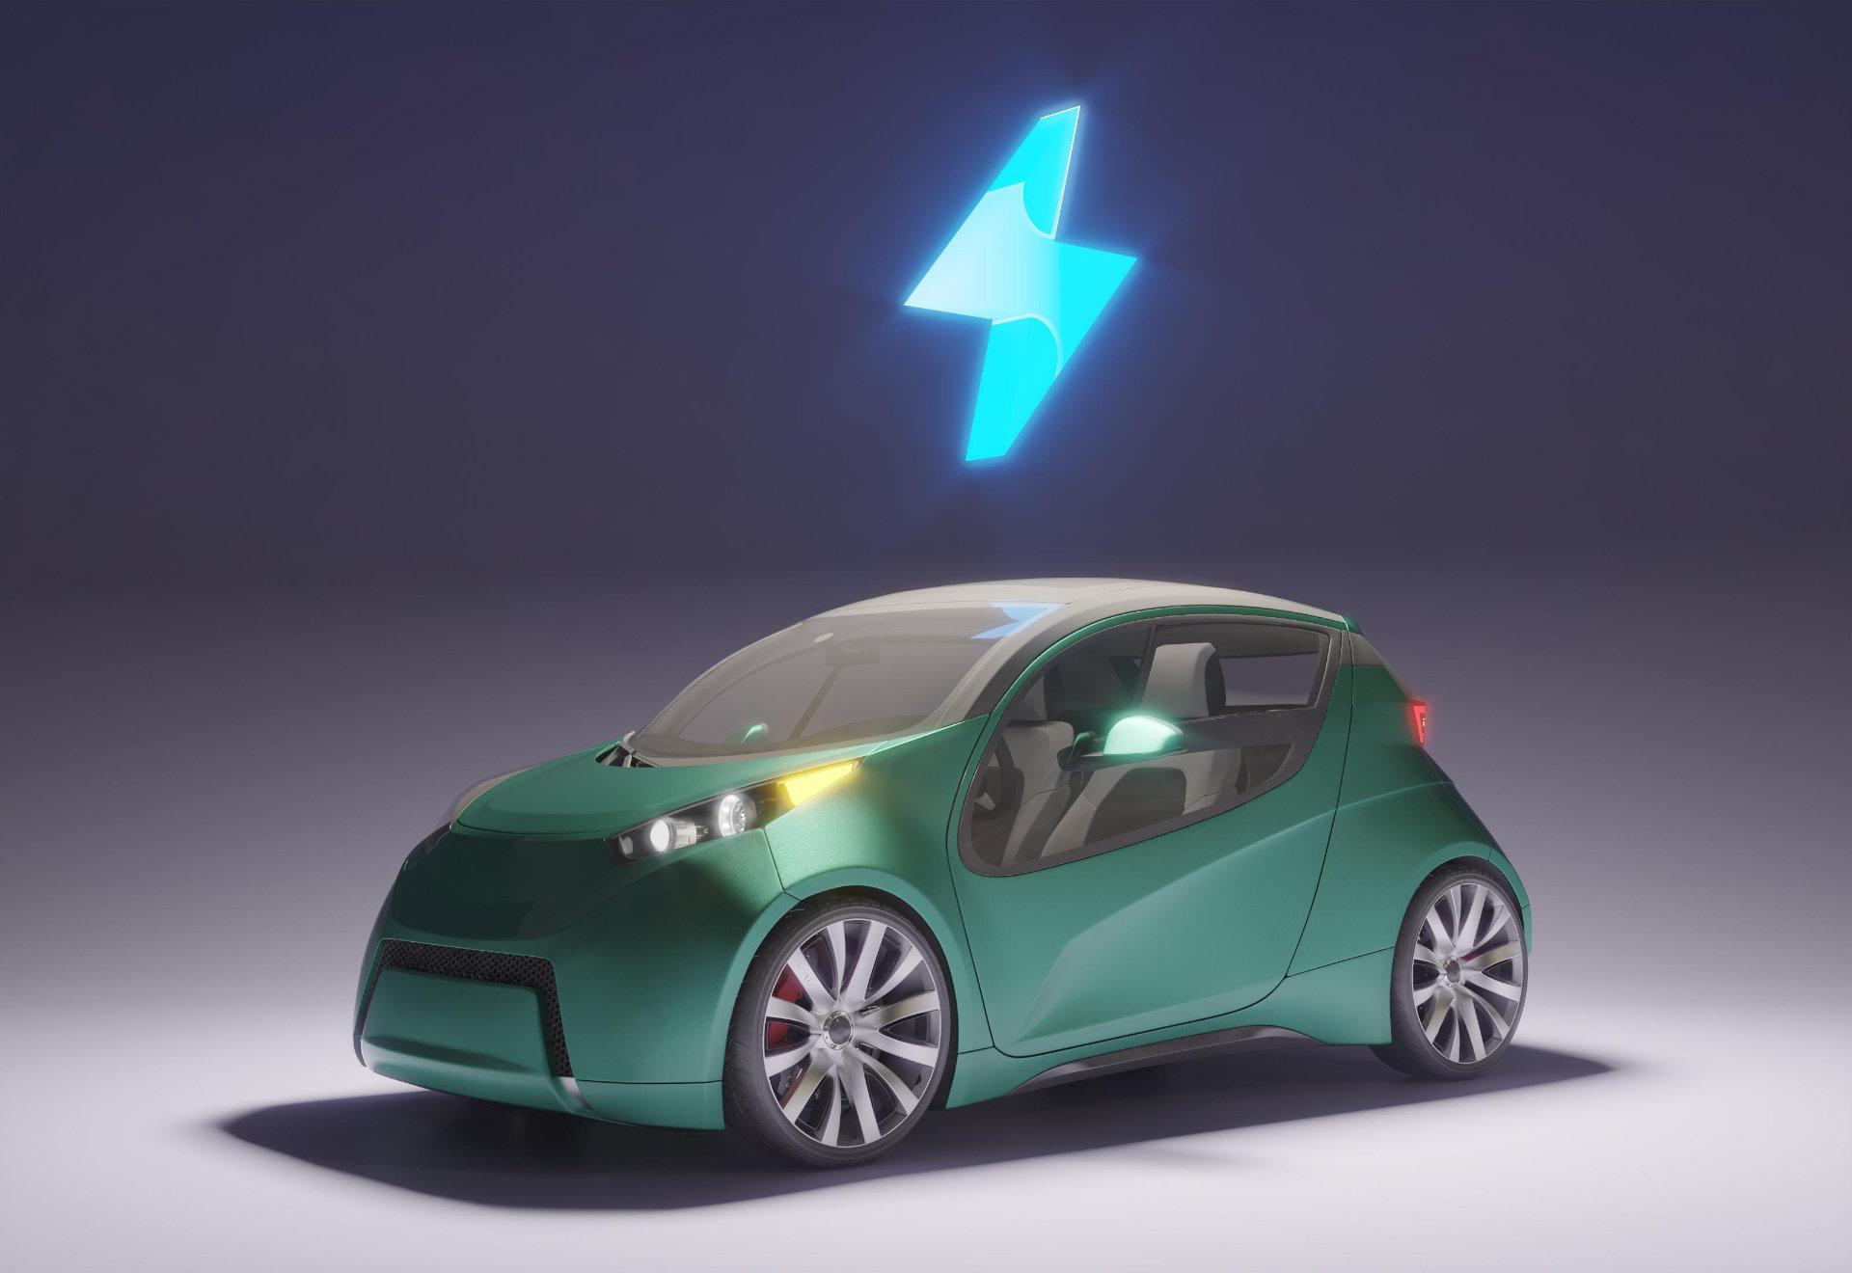
Behind the Wheel A Data Story of Rideshare Fares
Fasten Your Seatbelts for Data Exploration

Slide 2
TABLE OF CONTENTS
01
02
03
04
05
06
Introduction
Dataset overview
Data cleaning
Detailed Analysis
Key Insights
Recommendations

Slide 3
— Daniel Keys Moran
“You can have data without information, but you can’t have information without data”

Slide 4

Team Members
 | Name
 | Hazem Ayman (Team Leader)
 | Abdallah Ehab
 | Asmaa Elsayed
 | Anas Shbaita
 | Jana Aly
 | Omar Mansour
 | Mariam Yasser
 | Salma Muhammed Entsar

Slide 5

01
Introduction
Let’s make our Story begins!

Slide 6
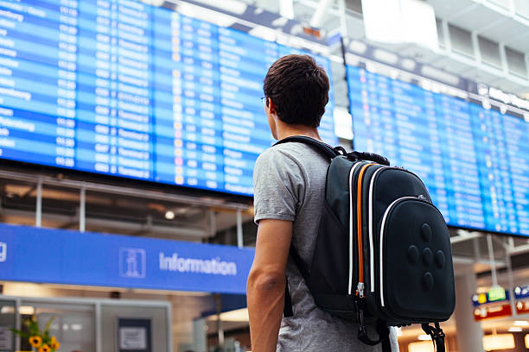
Context
Ridesharing services have revolutionized urban transportation by offering a convenient alternative to traditional taxis. With platforms like Uber, users can book rides via mobile apps, providing flexibility and ease. This analysis focuses on a rideshare dataset, akin to a company like Uber, to understand patterns in urban mobility and consumer behavior.

Slide 7

Objective
The goal of this exploratory data analysis (EDA) is to uncover insights and trends within the rideshare dataset. We aim to examine how fare amounts vary by time of day, day of the week, and seasonality. By identifying patterns and anomalies, we seek to inform business strategies and enhance operational efficiency for ridesharing services.

Slide 8
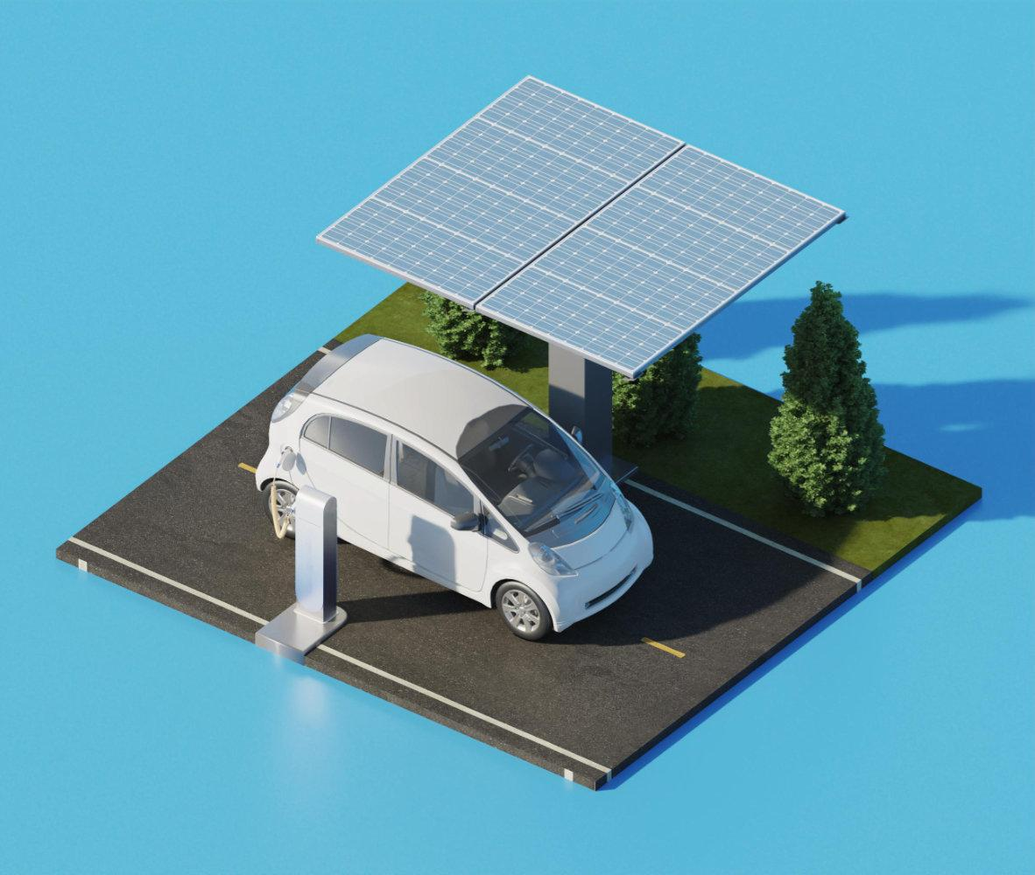
Dataset Overview
02
Let’s define the structure of our dataset

Slide 9
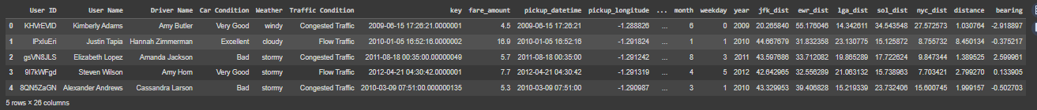
— Here are some first 5 rows of our data.

Slide 10
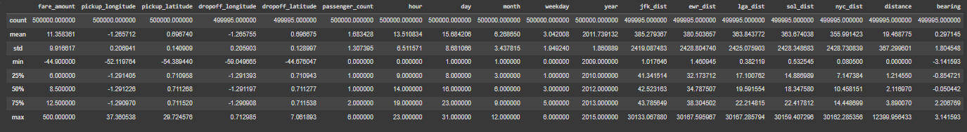
— Here are some statistical findings regarding our data.

Slide 11
Features of our dataset
01
User Id
06
Traffic Condition
11
Dropoff Longitude
02
User Name
07
Key
12
Dropoff Latitude
03
Driver Name
08
Pick up Date
13
Passenger Count
04
Car Condition
09
Pickup Longitude
Hour
14
05
Weather
10
15
Day
Pickup Latitude

Slide 12
Features of our dataset
16
Month
19
lga_dist
22
jfk_dist
17
Weekday
20
sol_dist
23
ewr_dist
18
Year
21
nyc_dist
24
Distance
25
Bearing
26
Fare Amount

Slide 13

Data Cleaning
03
Get Ready for Insights: Outliers Out! 🔍✨

Slide 14
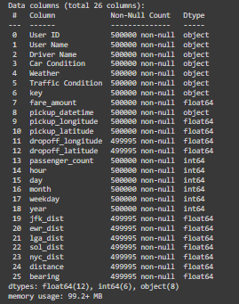
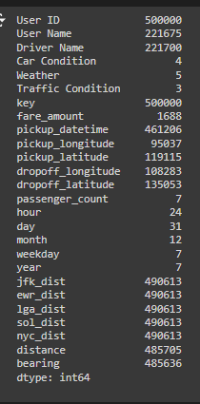
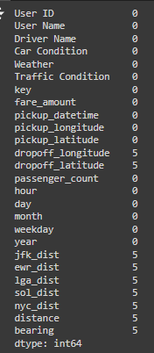
General Info and Data types
Data Types
Unique
Nulls

Slide 15
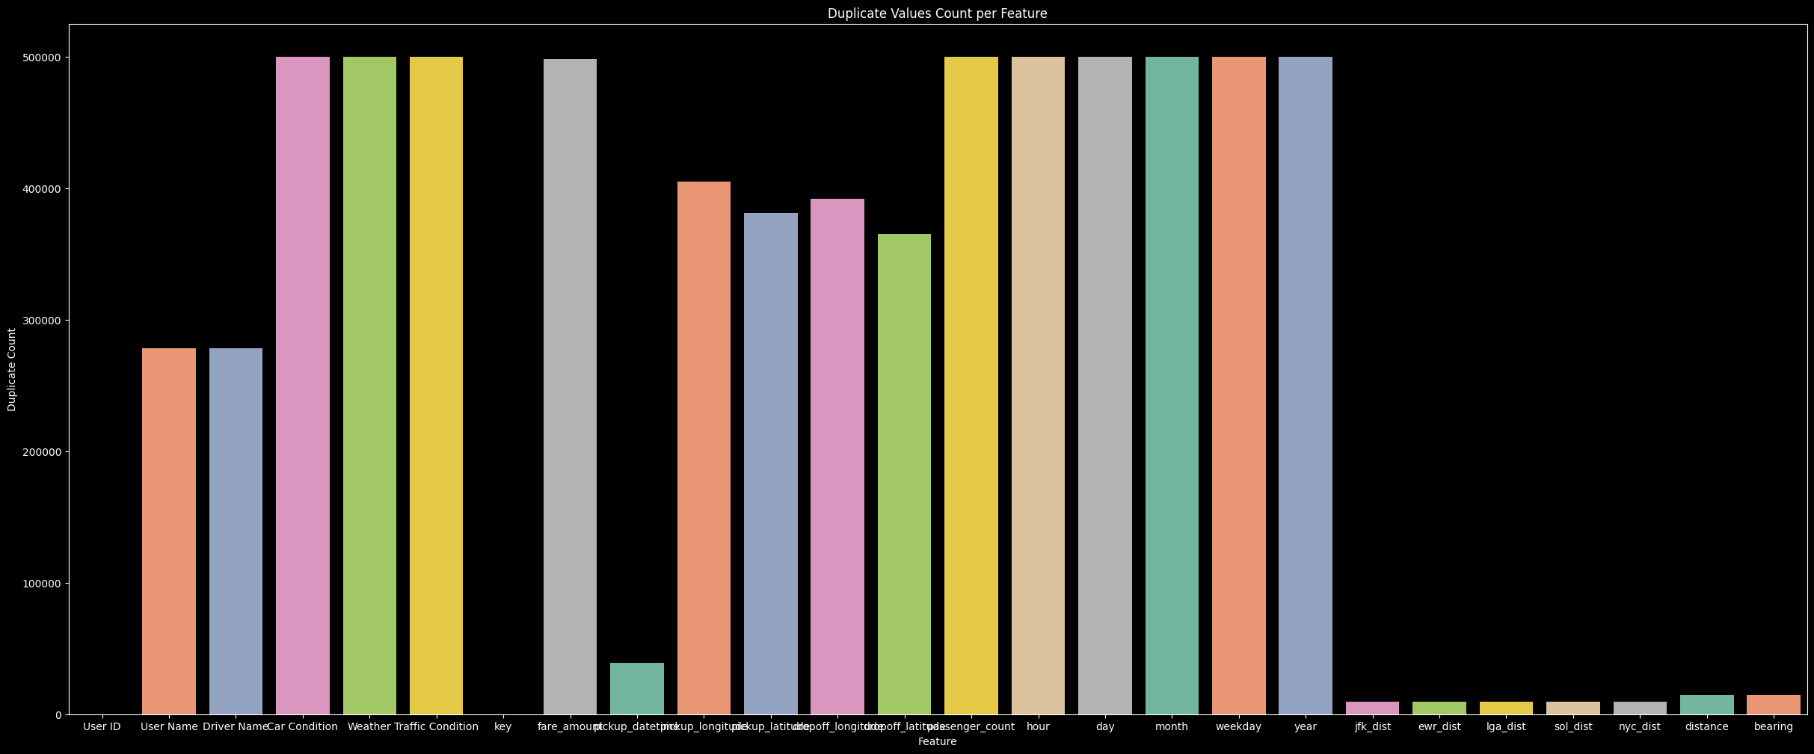
Dublicate Values

Slide 16
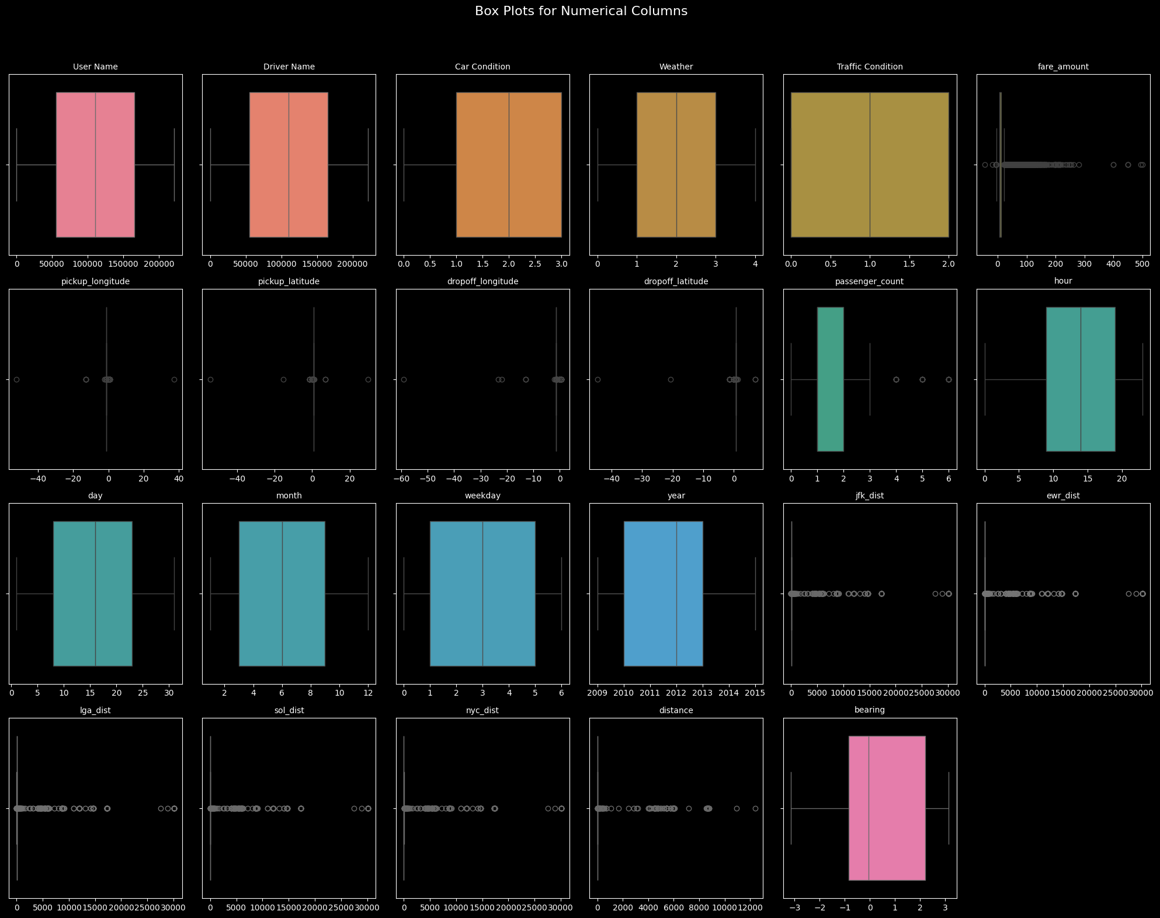
Box Blots of each Feature

Slide 17
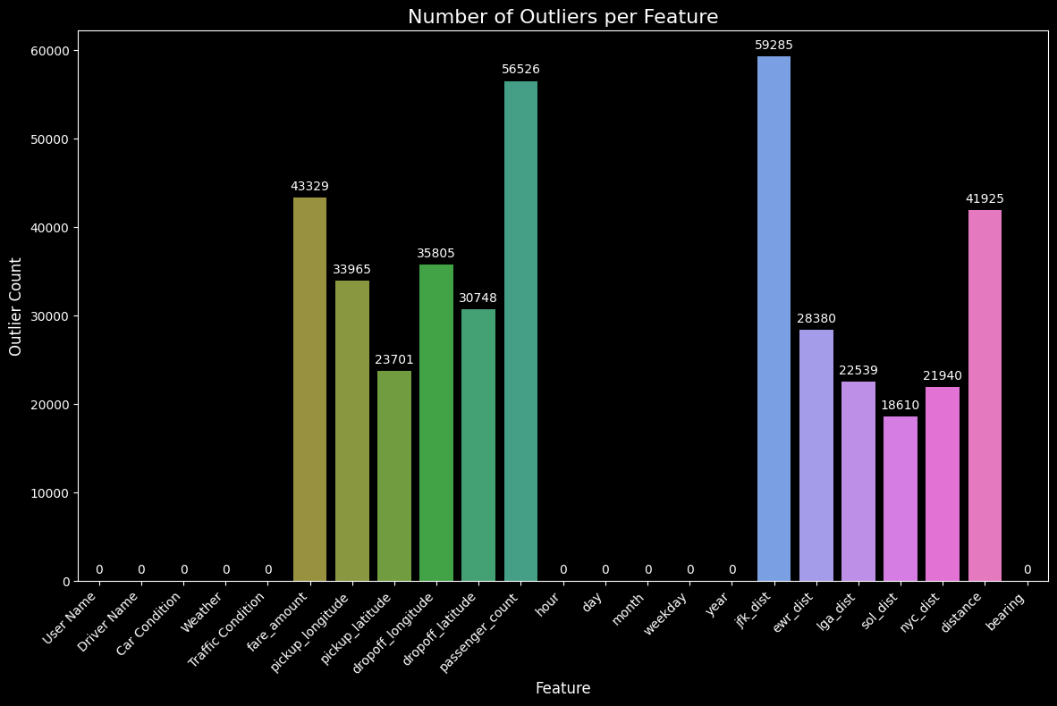
Outliers Values

Slide 18
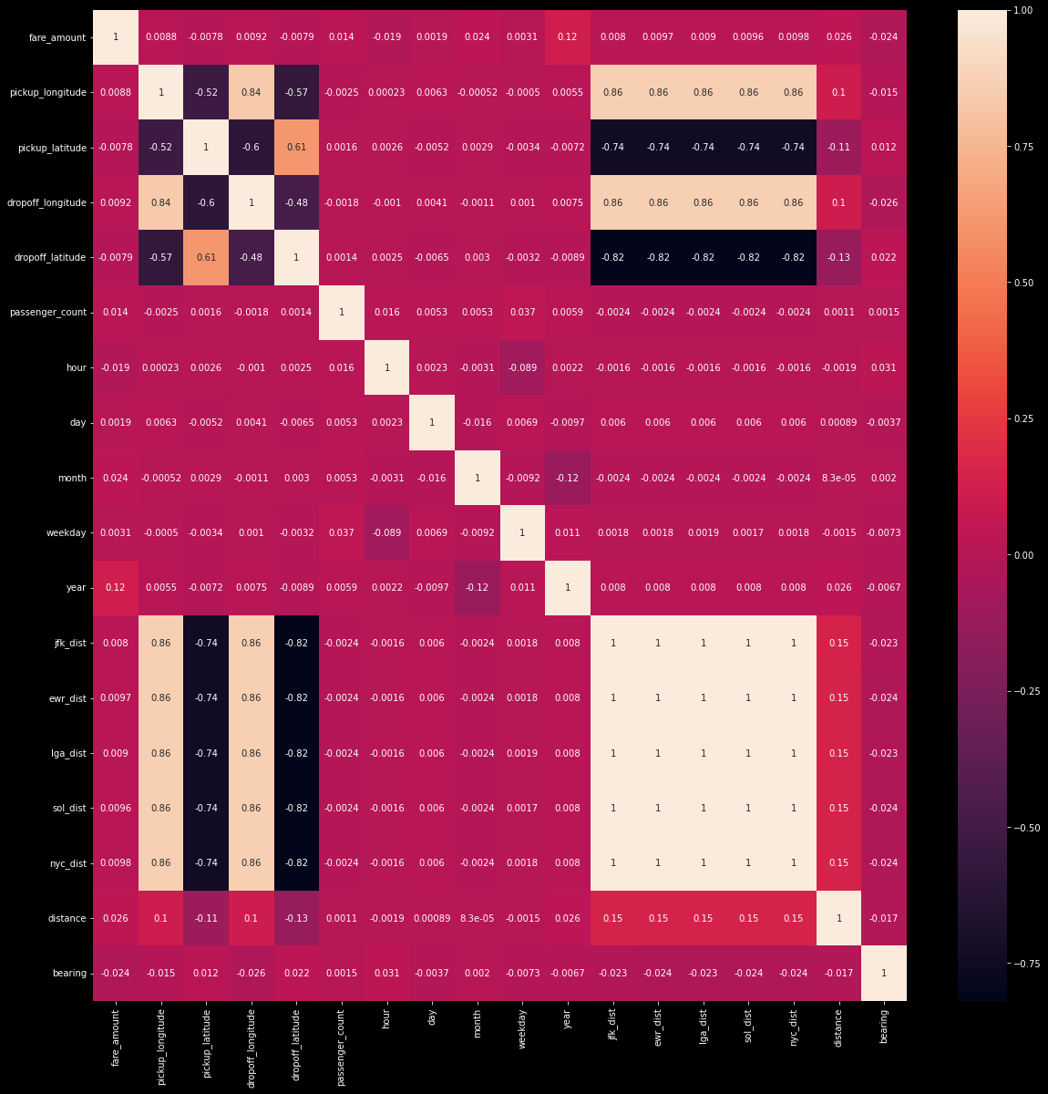
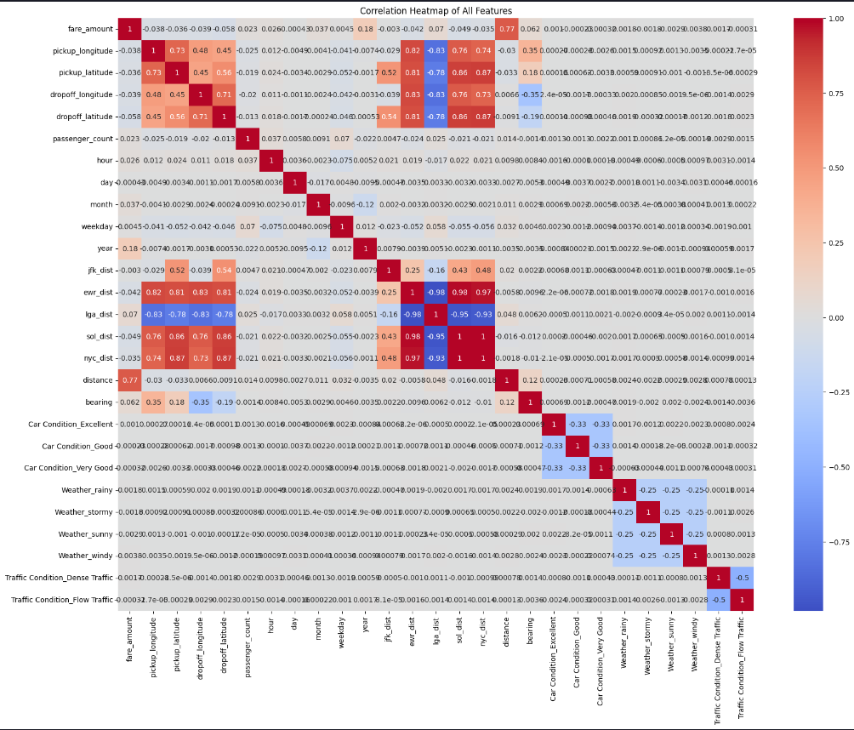
Effect of outliers in correaltion
Correlation matrix before
Correaltion matrix after outliers

Slide 19
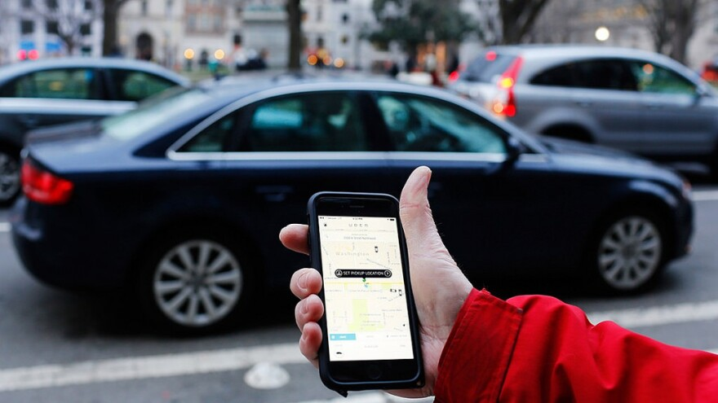
Detailed Analysis
04
Visualizing Connections: Uncovering Hidden Patterns in Our Data

Slide 20
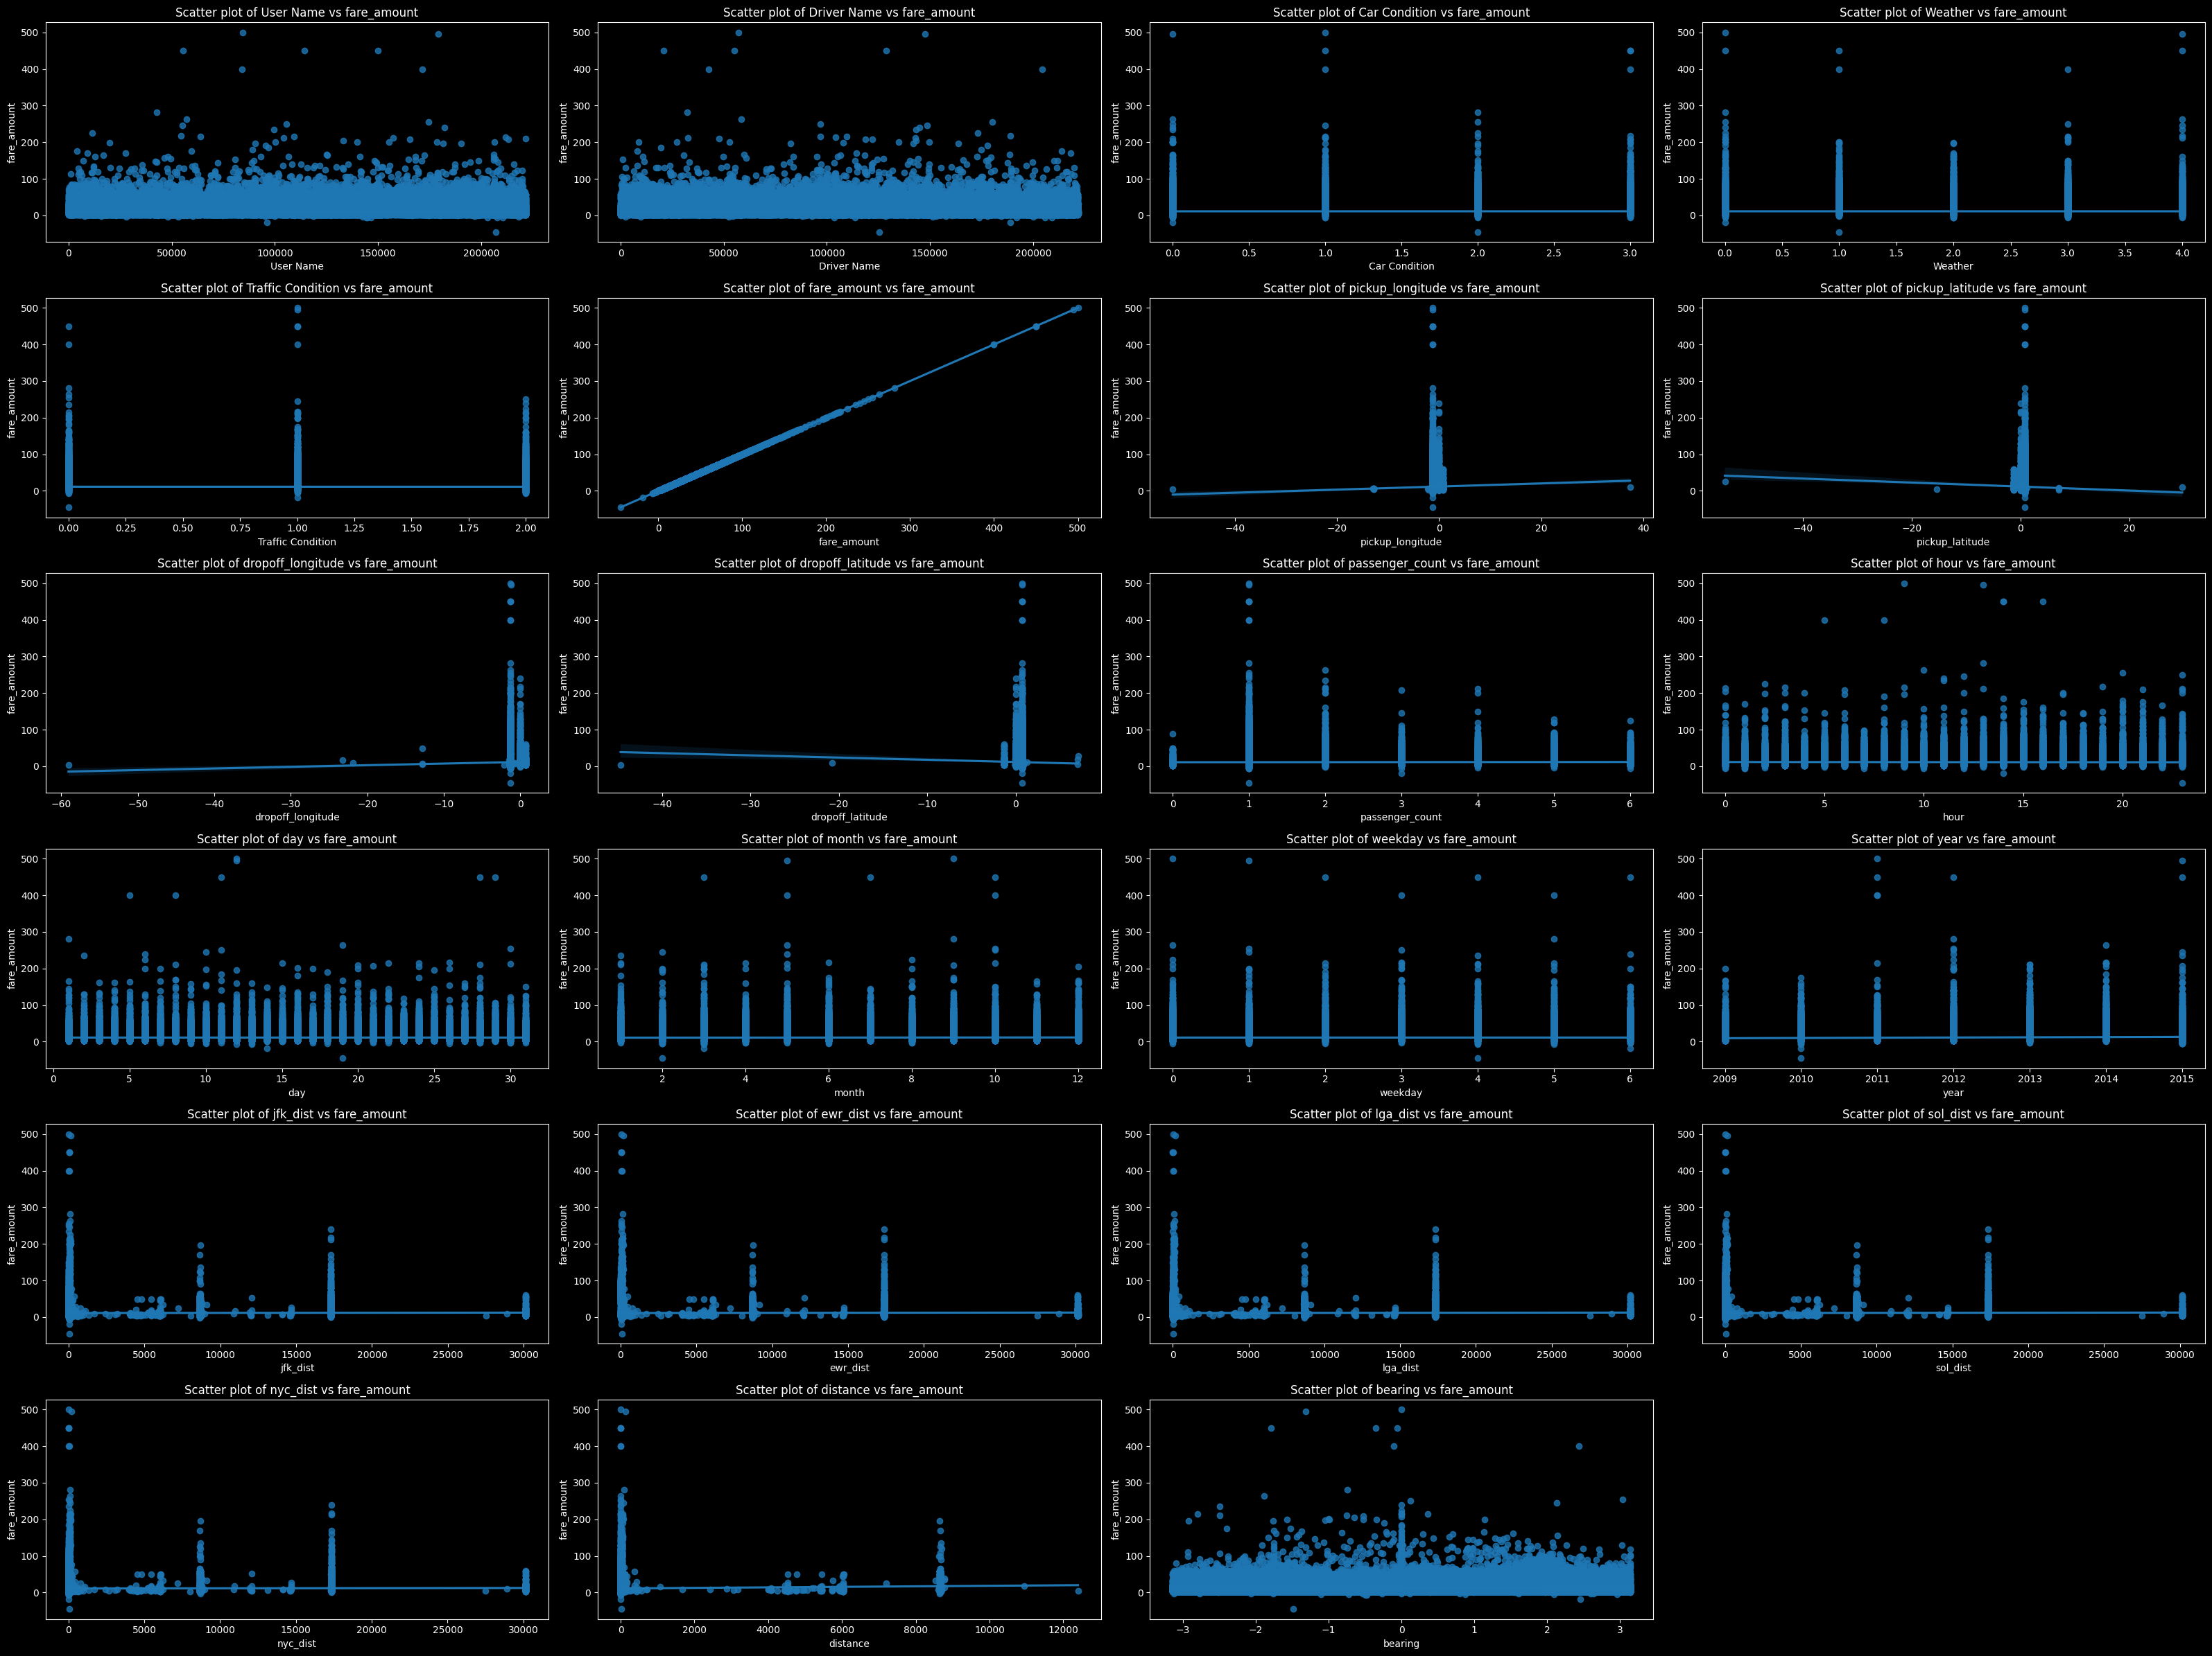
Scatters

Slide 21

Users vs Drivers

Slide 22
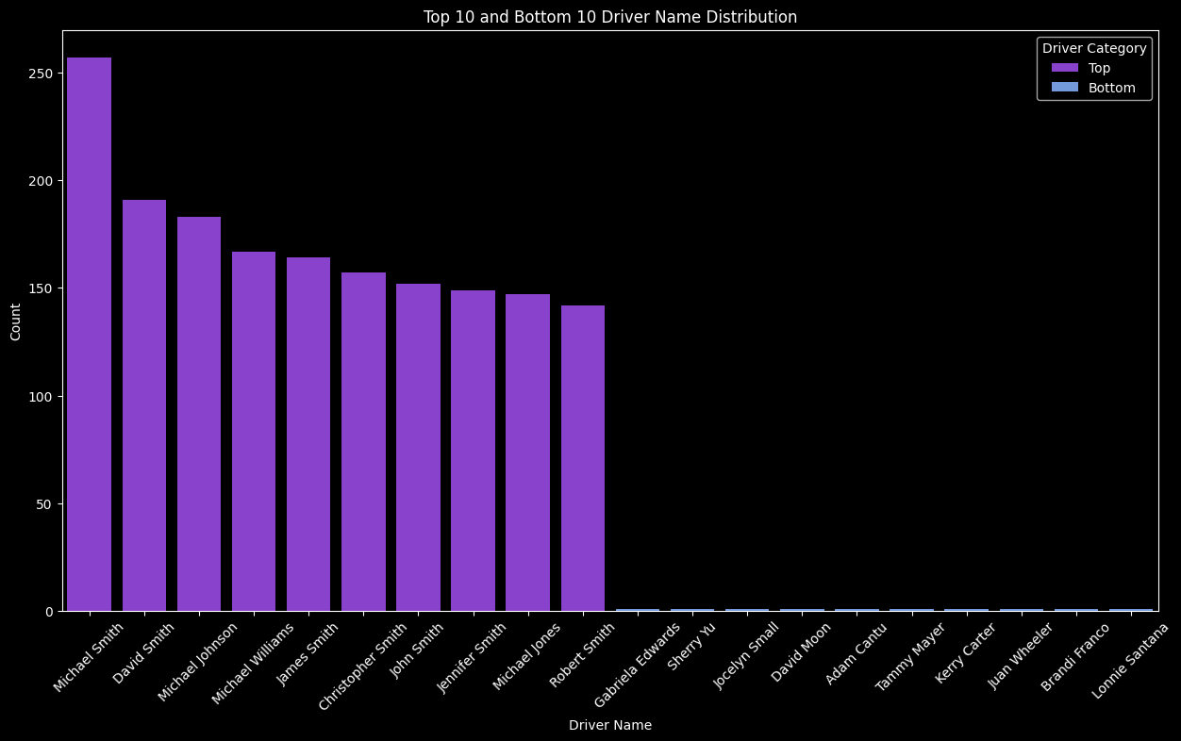
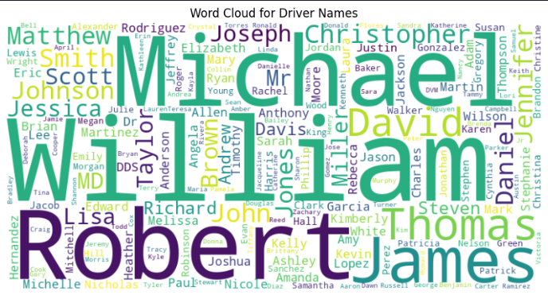
Drivers
The survey reveals that Michel Smith is the most requested driver, receiving 257 requests, which indicates a high level of demand. In contrast, there is a significant disparity in driver popularity, with 136,621 drivers each receiving only a single request. This highlights a substantial gap in the distribution of driver requests.

Slide 23
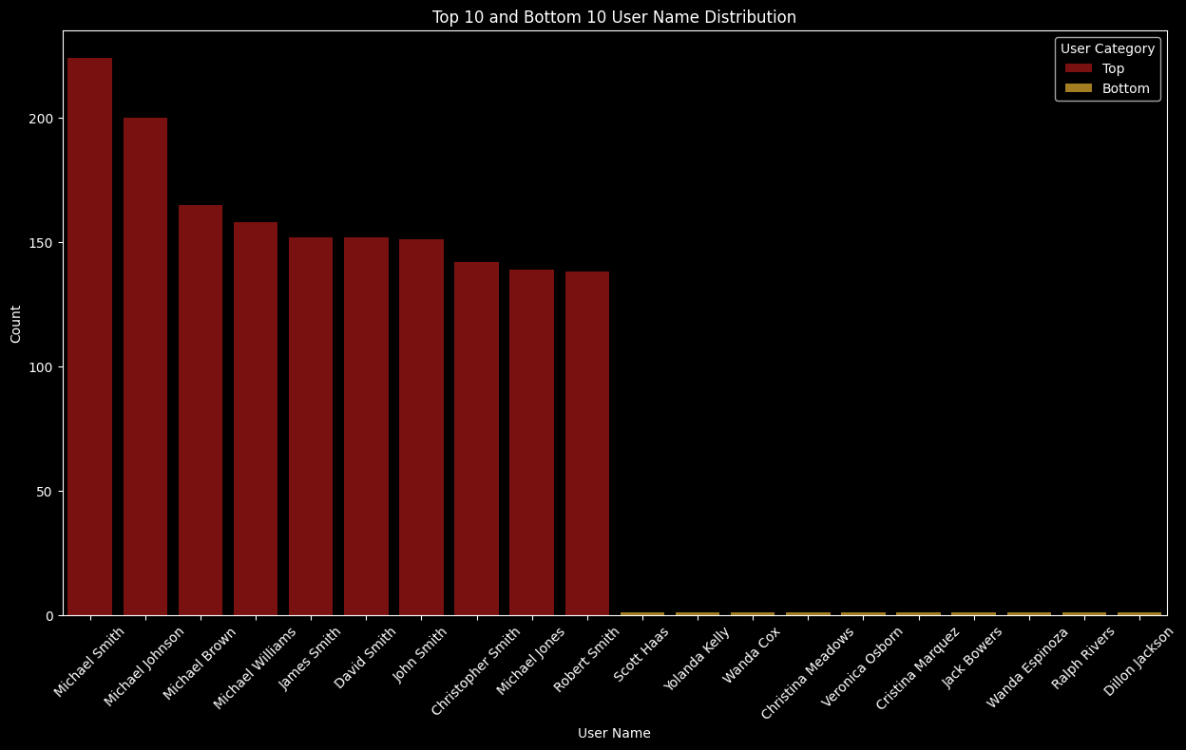
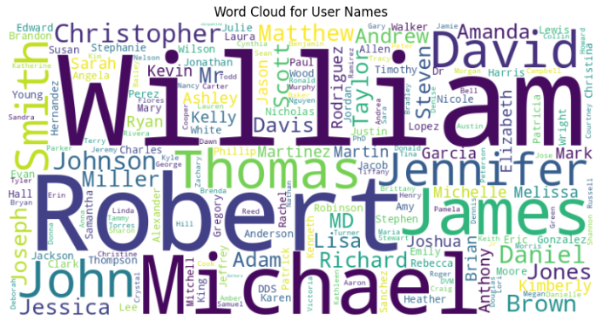
Users
The survey reveals that Michel Smith is the most frequently used user with 224 requests, reflecting a significant demand for their services. Conversely, a substantial number of users, totaling 136,386, each made only a single request, highlighting a wide distribution of low-usage patterns across the user base.

Slide 24
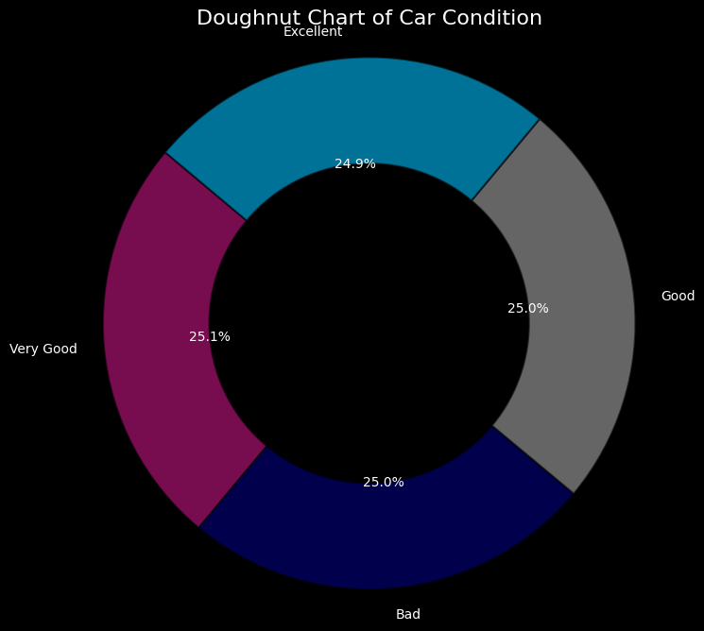
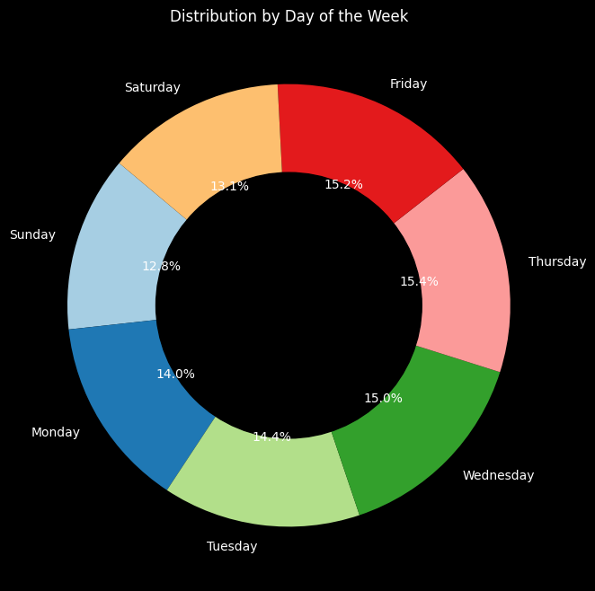
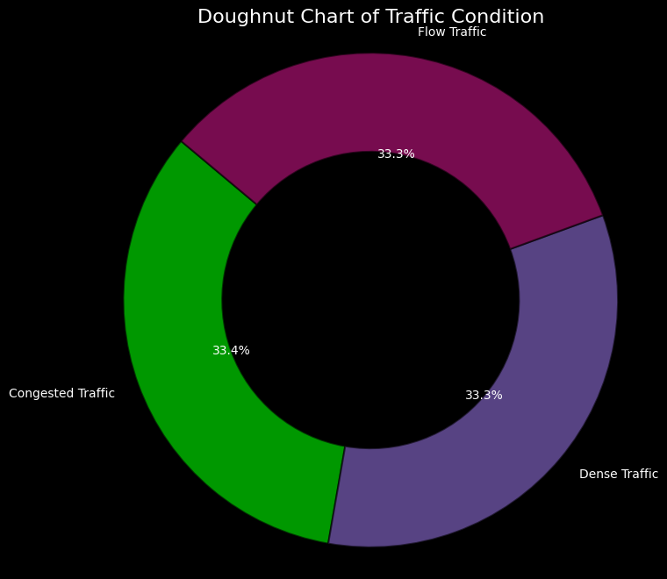
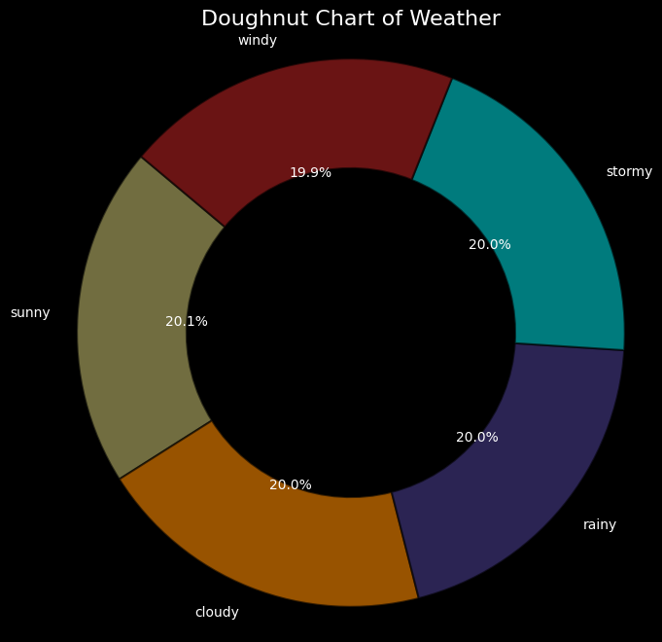
Donuts Surveys

Slide 25
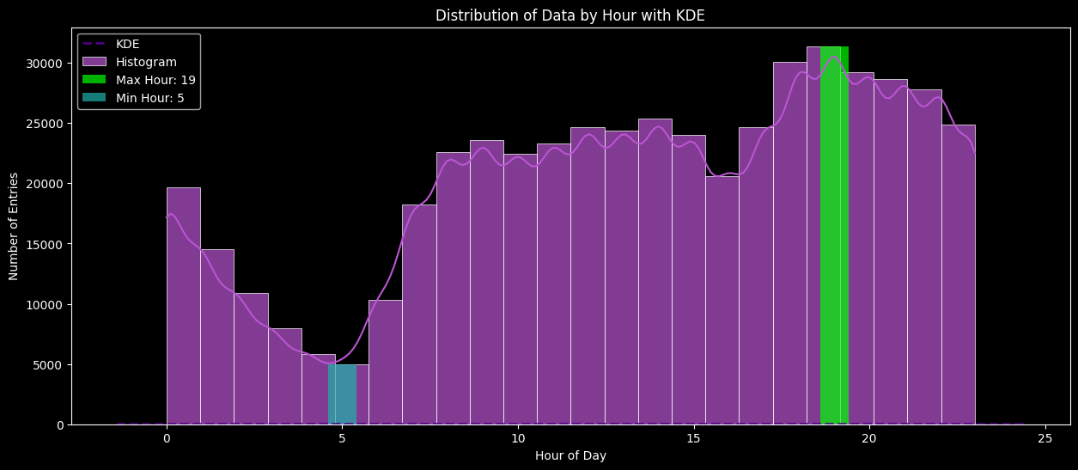
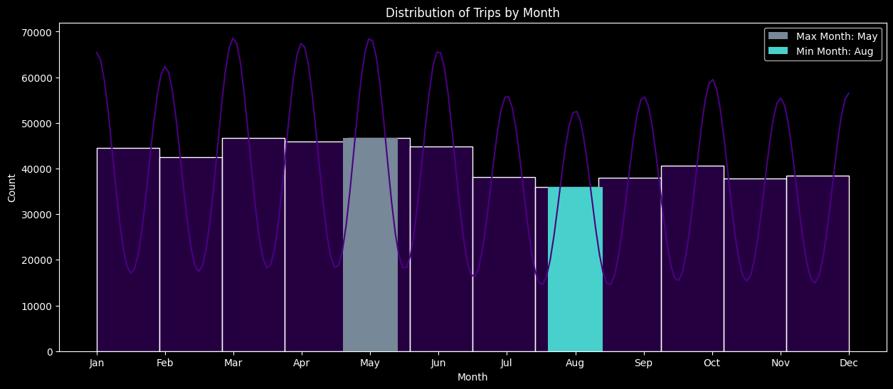
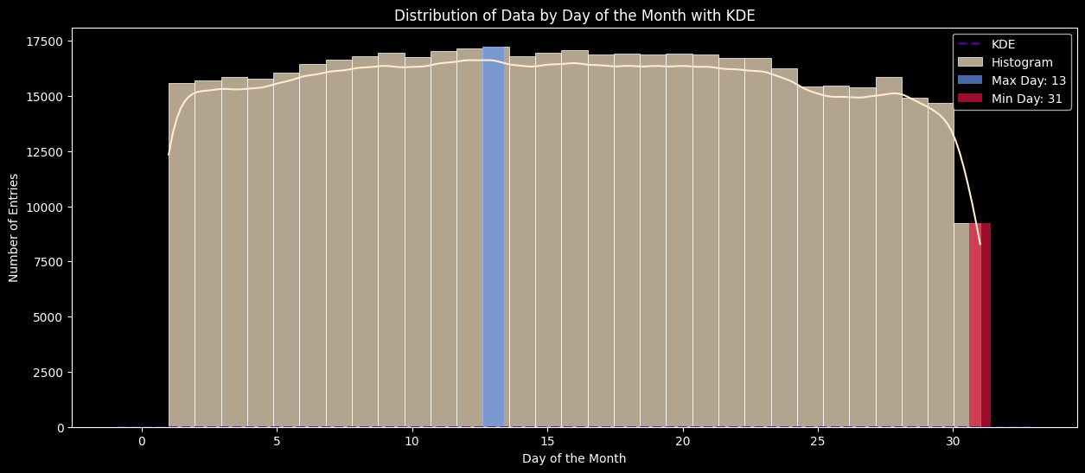
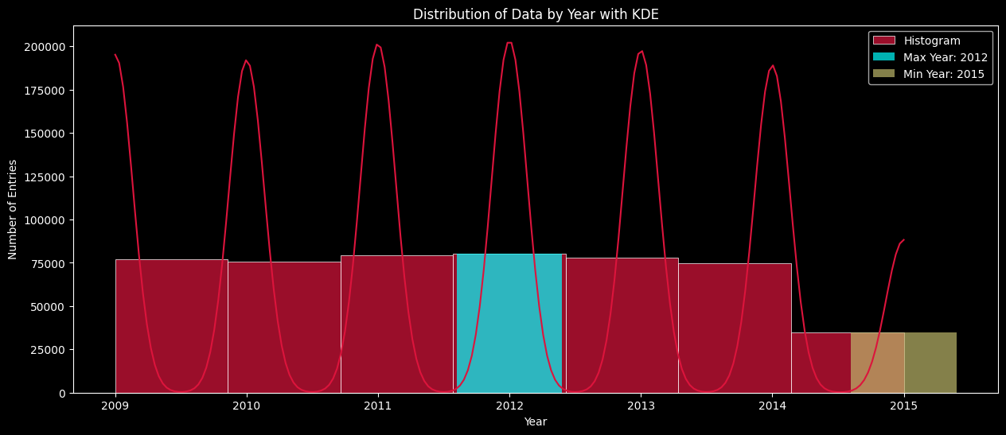
Time Trends

Slide 26

Fare Amount Analysis

Slide 27
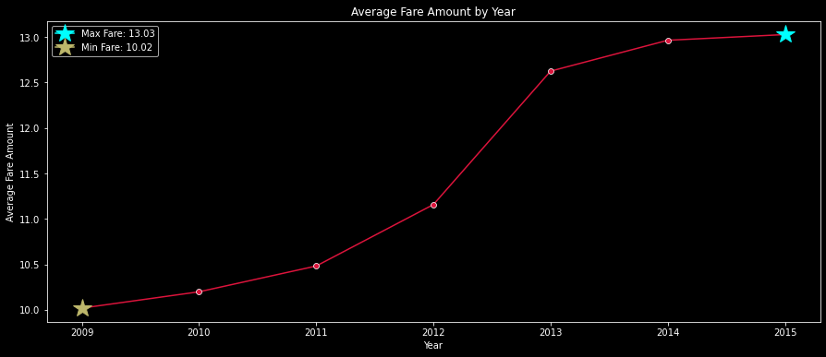
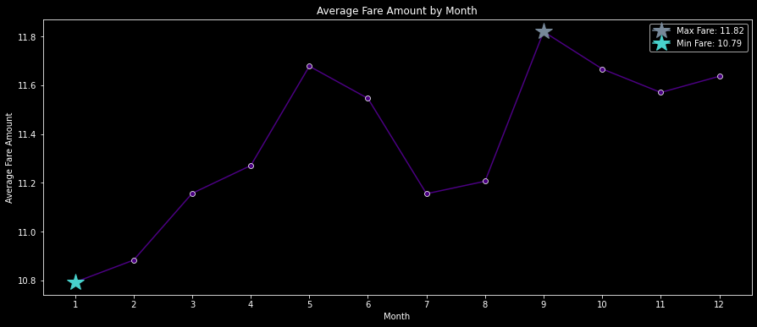
Year and Month
Year
Month
In 2015, the average maximum fare was $13.03, indicating the highest fare levels. In contrast, 2013 saw the lowest average fare of $10.02.
In September, the average maximum fare was $11.82, while January had the lowest average fare at $10.79.

Slide 28
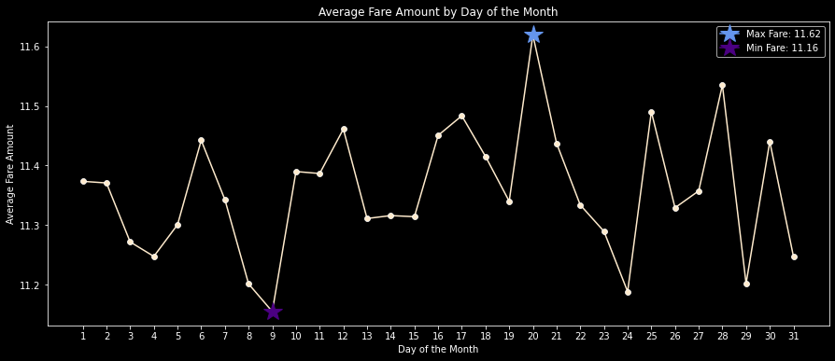
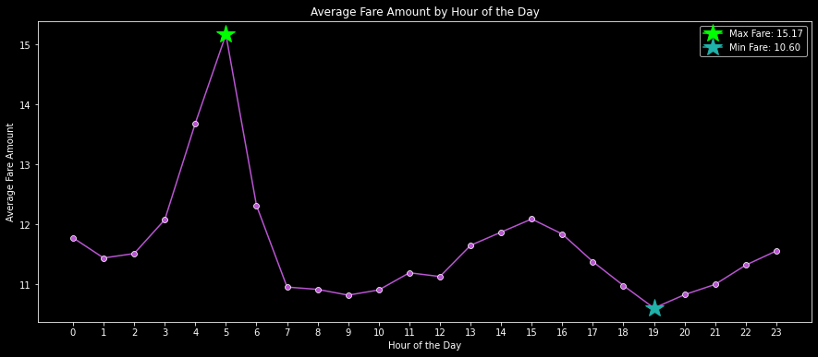
Hour and Day of Month
Day of month
Hour of the day
On the 20th day of the month, the average maximum fare was $11.62, whereas on the 9th day, the minimum average fare was $11.16.
The highest average fare of $15.17 occurred at 5 AM, while the lowest average fare of $10.16 was recorded at 7 PM.

Slide 29
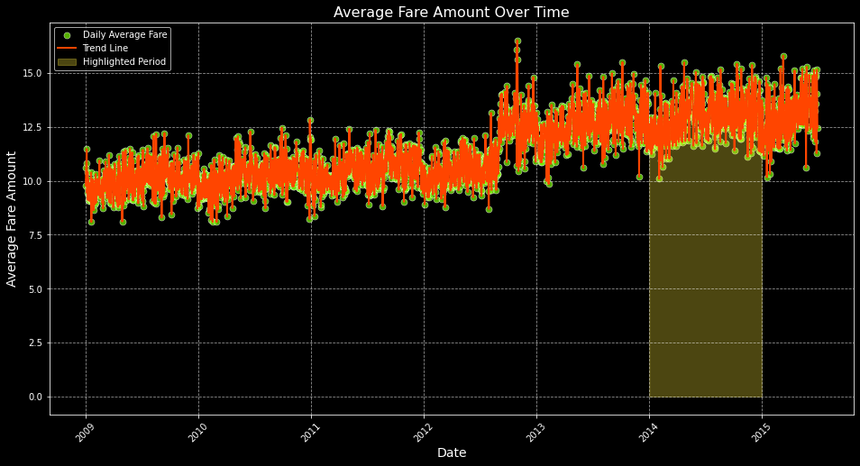
Total Times
We observed that the average fare amount peaked in May 2013, which might be attributed to specific events or circumstances in the country during that period, such as accidents or other significant factors.

Slide 30
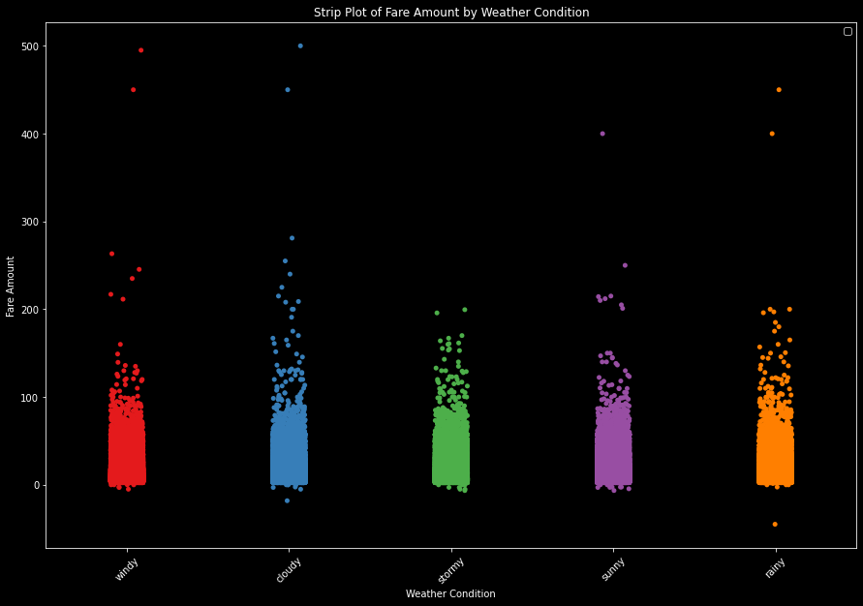
Weather versus Fare amount
Max
500 at Cloudy day which is resonable
Min
-45 at rainy day
May be the driver did something wrong

Slide 31
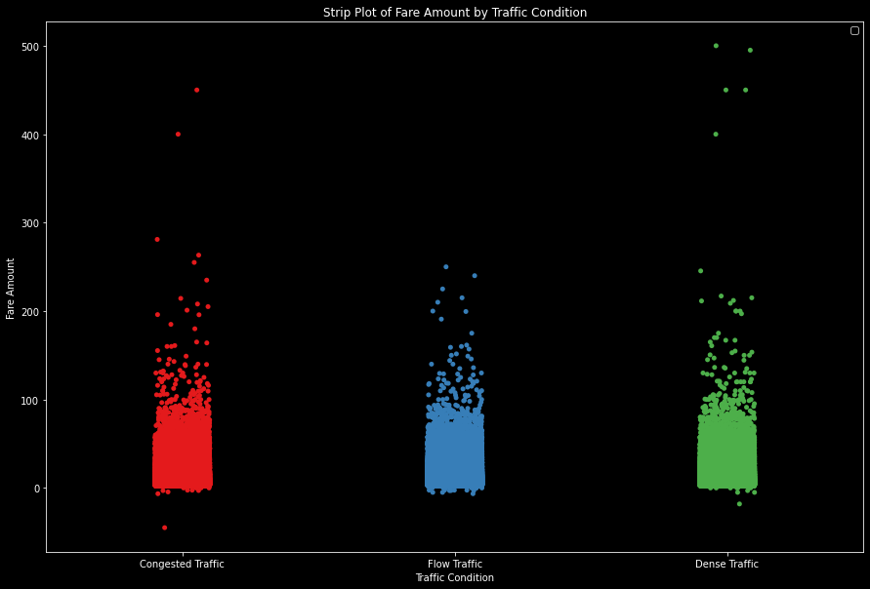
Traffic Condition versus Fare amount
Max
500 at Dense Traffic
which is resonable
Min
-45 at Congested Traffic
May be the driver did something wrong

Slide 32
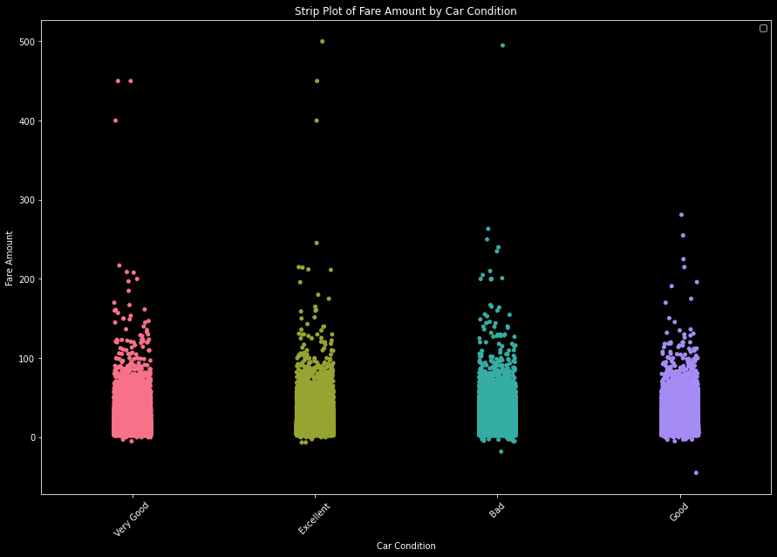
Car Conditions versus Fare amount
Max
500 at Excellent which is resonable
Min
-45 at Good
May be the driver did something wrong

Slide 33
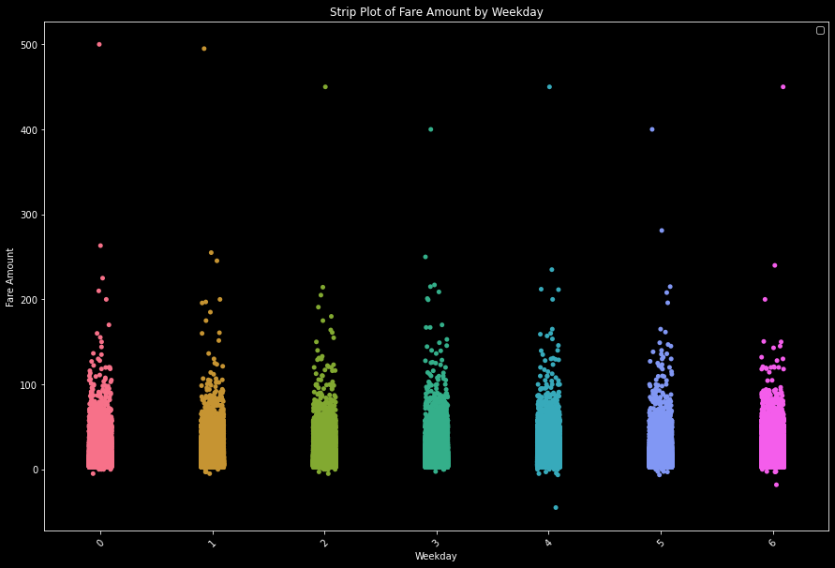
Weekday versus Fare amount
Max
500 at Monday
which is resonable due to back from weekends
Min
-45 at Friday
May be the driver did something wrong

Slide 34
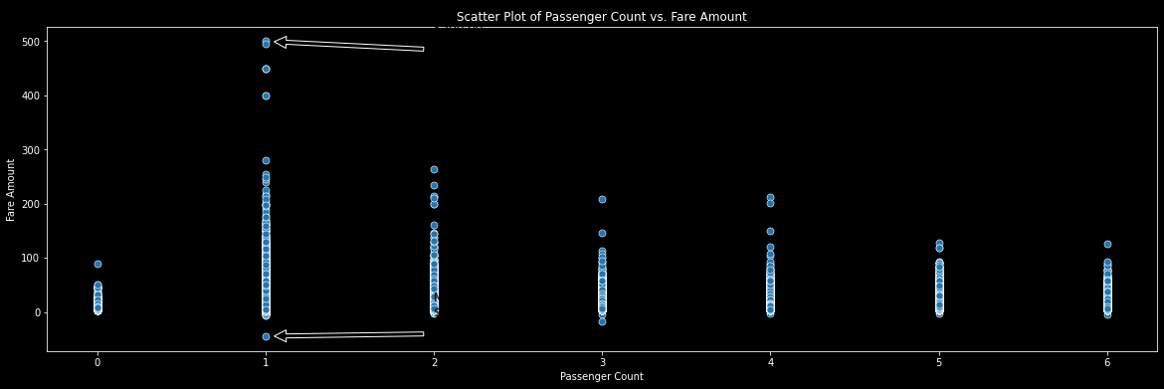
Passenger Count versus Fare Amount
$500
One passenger
May be due to long distance
-45
One passenger
May be as a discount or penalty to the driver
TOTAL
$100.000

Slide 35
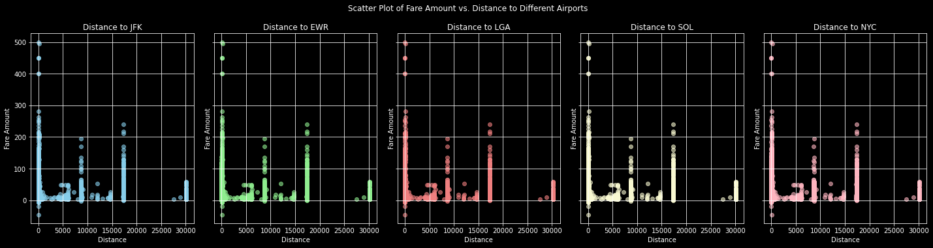
Distances from Airports and Fare amounts
The distances might be uniformly distributed across locations, meaning that there isn't much variation between them and fare amount is not affected with changing the airport.

Slide 36
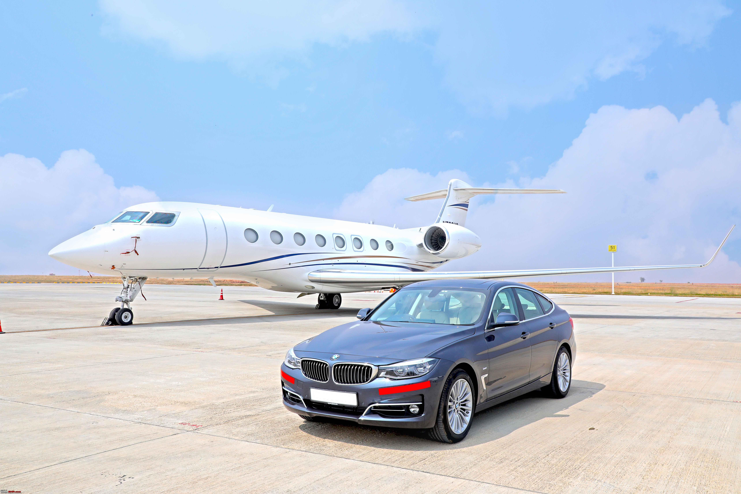
Distances Analysis

Slide 37
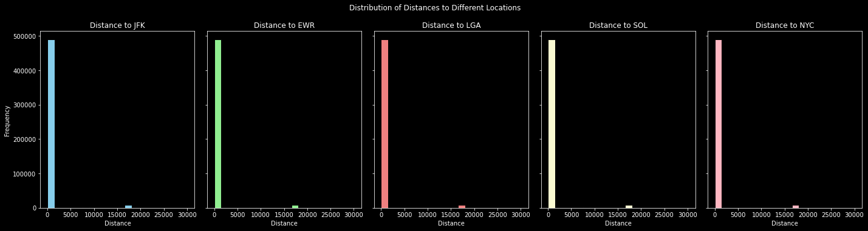
Distances from Airports
The distances might be uniformly distributed across locations, meaning that there isn't much variation between them.

Slide 38
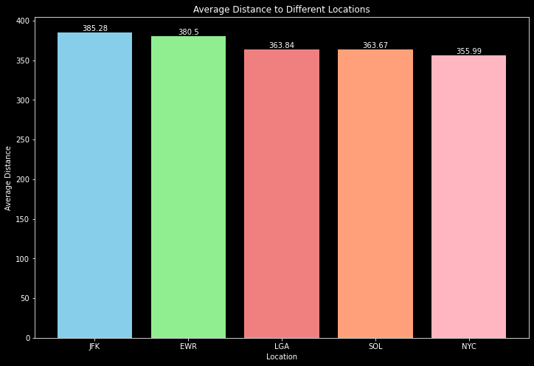
Average Distances from Airports
Max avg
JFK Airport
Min avg
NYC
Distances might be uniformly distributed across locations.

Slide 39
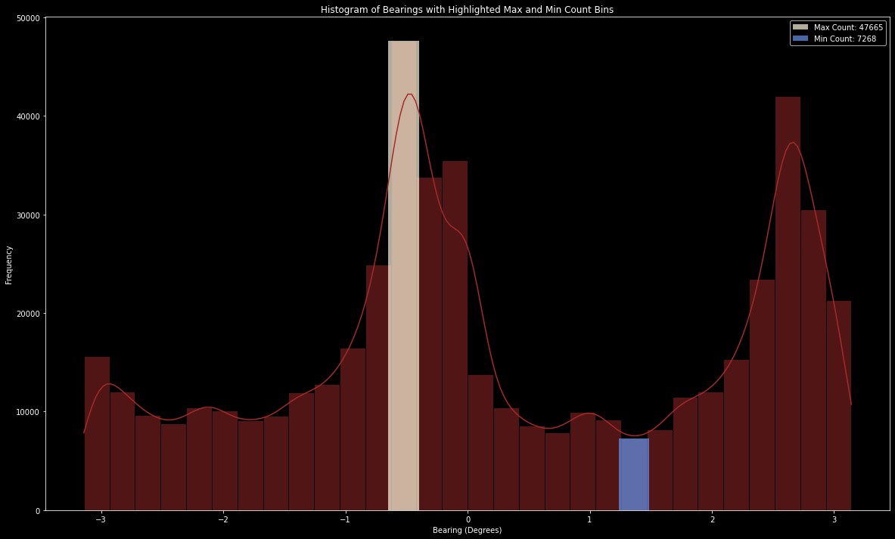
Distances from Airports
The maximum frequency of bearings occurs at approximately -0.6 degrees, with a frequency of 47,665. This indicates that the majority of the data is concentrated around this bearing angle.
The minimum frequency of bearings occurs at approximately 1.4 degrees, with a frequency of 7,268. This suggests that this bearing angle is less common in the dataset.

Slide 40

Key Insights
05
Ready for our final story

Slide 41
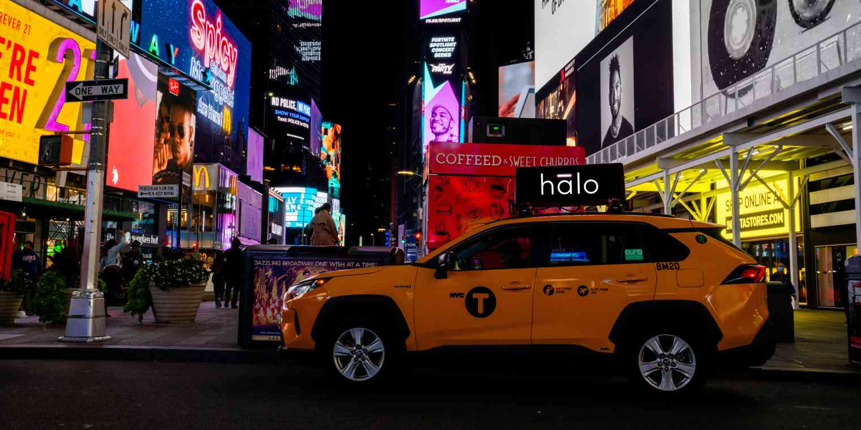
Company Overview
20% of drivers had only one request, suggesting limited brand recognition. Notably, Michael Smith stood out with 257 requests, highlighting a potential model for success. Similarly, 20% of users made only one request, while Michael Smith was the top user with 224 requests.
Weather conditions were evenly distributed, indicating reliable service across seasons.
Vehicle conditions varied, with 25% in each category ,showing room for improvement.
Traffic conditions were uniformly distributed, reflecting consistent service performance. Fridays had the highest ride requests, suggesting increased demand at week’s end.

Slide 42
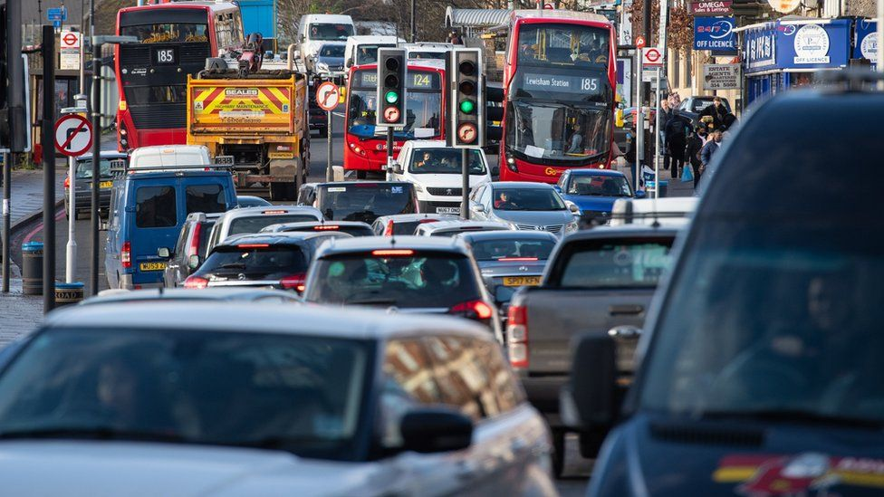
Time Trends
The busiest hour for rides was 7 PM, while 5 AM was the least busy. The 13th of the month saw the highest activity, and the 31st saw the least. May was the peak month for ride requests, and August had the fewest. In terms of years, 2012 saw the most activity, whereas 2015 had the least.

Slide 43
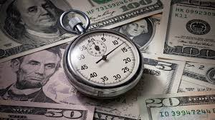
Fare Amount Trends
The highest average fare occurred in 2015, while 2009 had the lowest. Monthly fares peaked in September and were lowest in January. 5 AM had the highest average fare, as lower demand allowed for longer and more expensive trips, while 7 PM had the lowest average fare due to higher ride frequency. The 20th of the month saw the highest average fares, and the 9th saw the lowest.

Slide 44
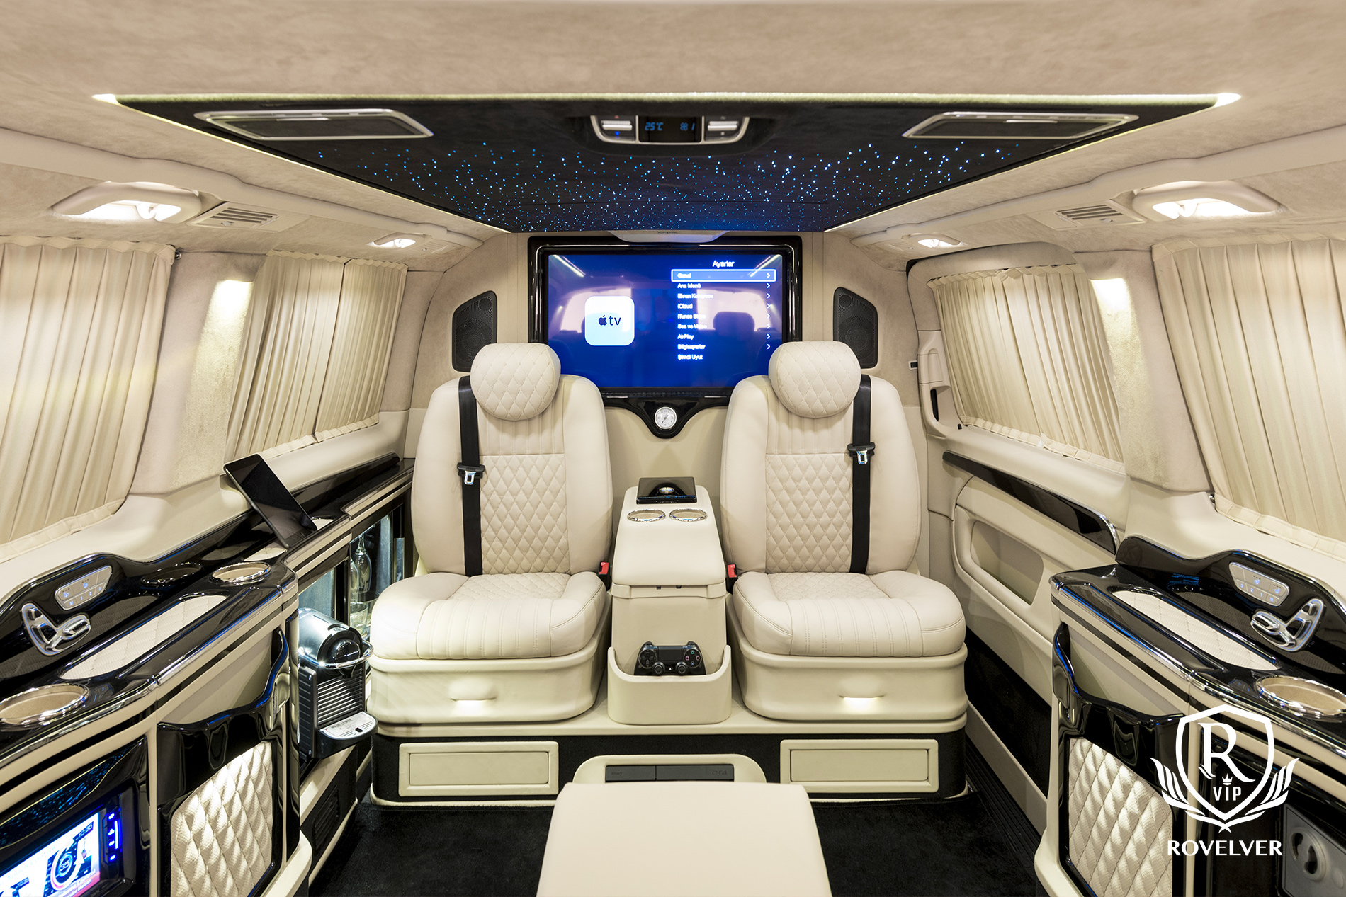

Max and Min Fare noticed
The maximum fare recorded was $500 on a cloudy day with dense traffic conditions and a car in excellent condition. This ride occurred at 9 AM on September 12, 2011, with one passenger, driven by Deborah Lopez, and the user was Hector Christensen.
Conversely, the minimum fare was -$45 on a rainy day with congested traffic and a car in good condition. This ride took place on February 19, 2010, with Tiffany Lloyd as the user and Kristin Roberts as the driver.

Slide 45

Distance Story
Distance and Fare Analysis:
The analysis of ride distances showed that all locations had similar distribution patterns, aligning closely with fare amounts, which suggests a consistent pricing model. Among the locations, trips to JFK had the longest average distance, while trips within NYC had the shortest, though the differences were slight.
Bearing Distribution:
The distribution of bearings highlighted a dominant direction, with the most common bearing at -0.6 radians, indicating a preferred travel route. Conversely, the least common bearing was at 1.4 radians, suggesting fewer trips were taken in that direction.

Slide 46

Recommendations
06
Actionable Insights for Operational Improvement and Growth

Slide 47

Recommendations
Increase Brand Awareness:
Launch marketing campaigns and referral programs to attract more drivers and users.
Driver Performance Optimization:
Develop training programs based on successful drivers like Michael Smith to boost engagement.
Vehicle Maintenance and Quality Control:
Implement regular inspections to keep vehicles in good to excellent condition.
Weather and Traffic Preparedness:
Implement surge pricing and train drivers for adverse weather and traffic conditions.
Optimize Ride Scheduling and Availability:
Align driver schedules with peak demand times, especially Fridays and evenings.

Slide 48

Recommendations
Fare Structure and Pricing Strategies:
Use dynamic pricing to adjust fares based on demand, distance, and time.
Enhance User Experience:
Improve user retention through personalized offers and loyalty programs.
Data-Driven Decision Making:
Use bearing analysis to optimize routes and continuously adapt to market trends.
Safety and Security Measures:
Monitor high-value rides for enhanced safety and security measures.
Customer and Driver Feedback Mechanisms:
Implement feedback systems to capture insights for service improvement.

Slide 49
THANK YOU!
DOES ANYONE HAVE ANY QUESTIONS?
Team 1 Group 1

